Slide 1
WELCOME TO STUDY AT
SAMARKAND STATE UNIVERSITY
Samarkand State University is one of the largest universities in Uzbekistan. More than 18,000 students from various regions of Central Asia study at the university.
We are happy to see in the number of students of SamSU those who set a goal - to get a quality and modern education. Always aspire to learn new, be inquisitive and do not be afraid of difficulties. All this will help to realize your potential and will give a successful start for a future career in science, culture and education.
We are waiting for you at our university!

Slide 2
Samarkand State University
SamSU reopens a faculty of LAW in 2020
The number of students at SamSU has grown from 17000 to 18000
in 2020

Slide 3
Programs Offered by University
Physics
Mechanics - mathematics
Geography and ecology
Economics and business
Phycology and sociology
Doctoral Programs
Biology
Chemistry
Pedagogics
History
Physical education
Philology Uzbek and Tajik
Russian philology
Pre-School Education
Applied Mathematics and Informatics
International Program Education
Notes:
© Copyright Showeet.com

Slide 4
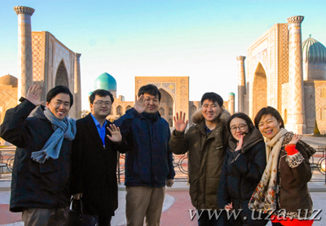
AT Samarkand state university FOREIGN CITIZENS can:
obtain a bachelor's and master's degree in the fields of their interest: natural sciences and humanities;
prepare a thesis for the degree of candidate of science (postgraduate study) and doctorate;
undergo a scientific internship;
pass university training program for further education at the university
PAYMENT FOR TRAINING
Training of foreign students is carried out on a fee basis. Its cost is established from the moment of admission to the first year and does not change during the entire period of study

Slide 5
PREPARATORY DEPARTMENT
Training at Samarkand State University, as well as at other higher educational institutions in Uzbekistan, is conducted in Uzbek, Russian and English
Foreign citizens should receive language training at the university preparatory department, in case they need it
Within 10 months, students can learn Russian, as well as special disciplines (mathematics, physics, foreign language, etc.)
Upon successful passing of exams, students receive a language certificate, which entitles them to enroll at the first course of the university in their chosen specialty
Classes at the preparatory department are held annually from October 1st. The group consists of 8-10 people. Training at the program of the preparatory department of the Samarkand State University is based on modern teaching methods, the latest teaching methods and materials

Slide 6
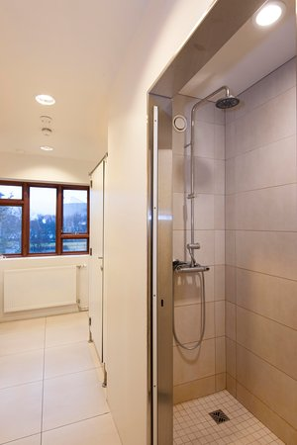
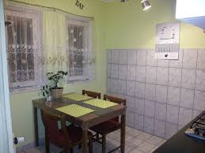
FOREIGN STUDENTS ARE PROVIDED BY THE ROOM IN A COMFORTABLE HOSTEL
Foreign students are provided with a free hostel.
During the training, you will be given a place in the hostel located on the campus. Comfortable rooms are designed for two or three people. At your disposal, there will be bathroom and kitchen
The hostel is a multi-national student family, and we hope very much that living in it will bring you much pleasure, joy and new acquaintances, because here you can find many friends from all over the world. Communication with students from the regions of Uzbekistan will help you not only get acquainted with Uzbek culture, but also provide a regular language practice.
We hope that this information will be useful and will help you become a student of the Samarkand State University! You can contact international office for any questions of interest.
More detailed information about the university and the training of foreign students at our university is on the web page of the university at: www.samdu.uz

Slide 7
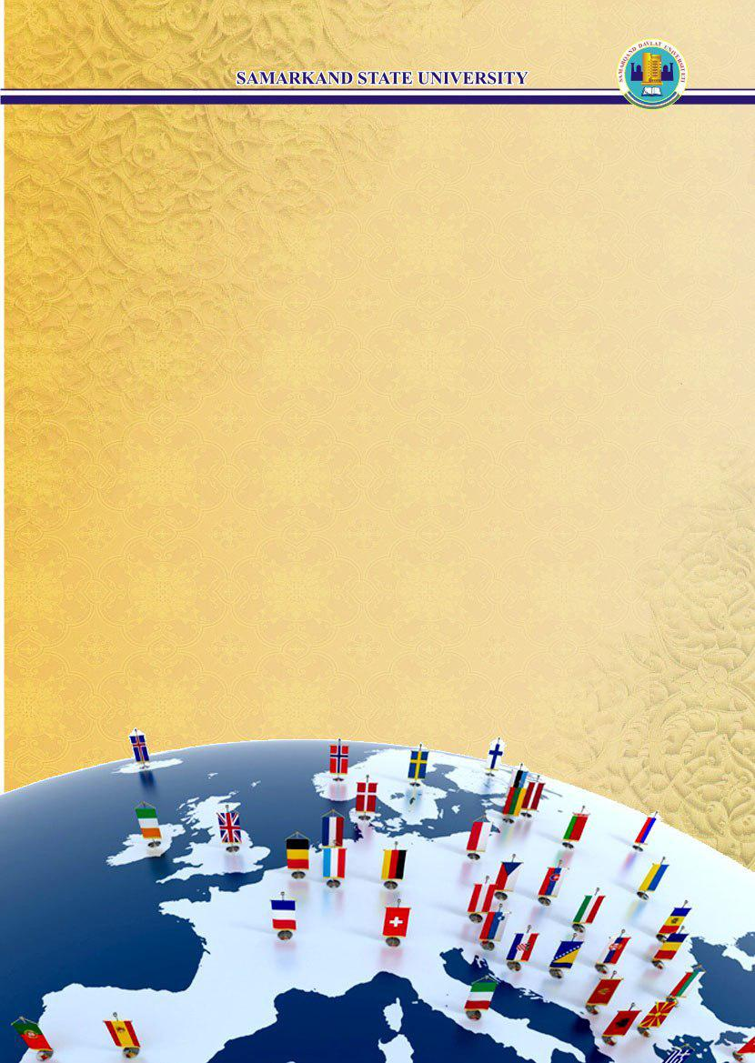
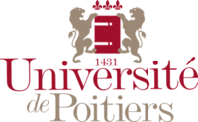
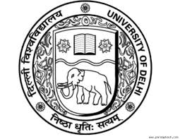
SamSU has PARTNERSHIP AGREEMENTS WITH MANY
PRESTIGIOUS UNIVERSITIES IN THE WORLD
IN EDUCATIONAL, SCIENTIFIC AND CULTURAL SPHERES

Slide 8
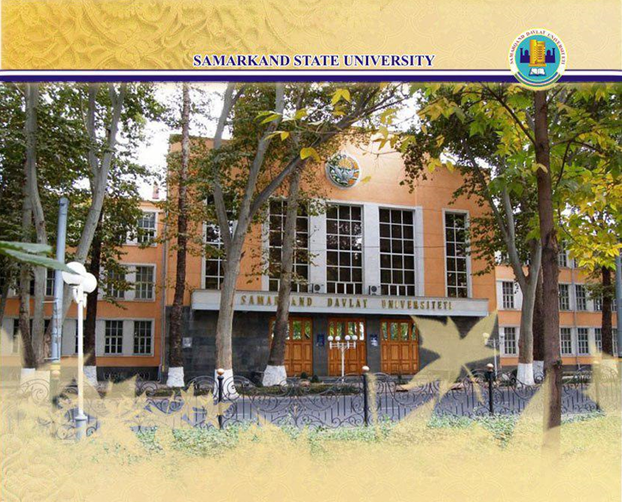
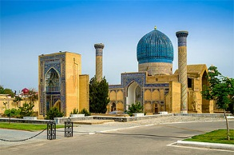
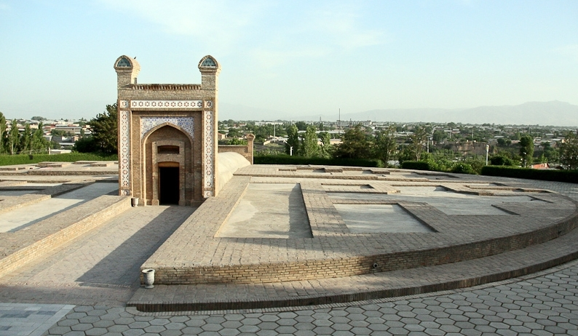
Samarkand is a crossroad of Great Silk Road and once the historical capital of the Timurid dynasty!
The city of Samarkand is located in the South-East of Uzbekistan, in the picturesque valley of the Zerafshan River, and Pamir-Alai Mountains.
Samarkand is known as the amazing city. Whatever epithets philosophers and poets could think of: the Mirror of the World, the Garden of the Soul, the Pearl of the East, the Face of the Earth - it is perhaps impossible to express all its beauty and richness in words. Enjoy firsthand all of its brilliance and splendor!
For its centuries-old history, this legendary city on the Great Silk Road has experienced the times of ups and downs, was reborn again and became even more beautiful. Trade routes to the West - to Persia, to the East - to China and to the South - to India intertwined here and formed crossroads of the Silk Road.
Notes:
Samarkand

Slide 9
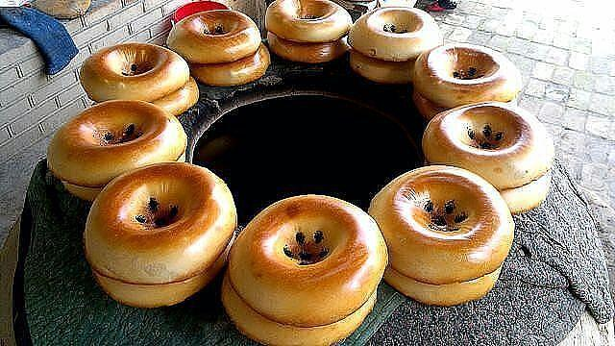
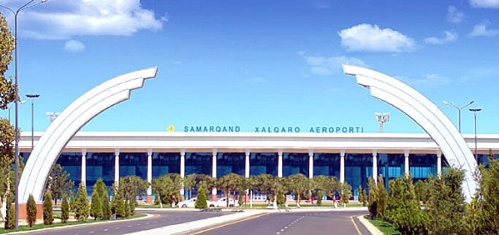
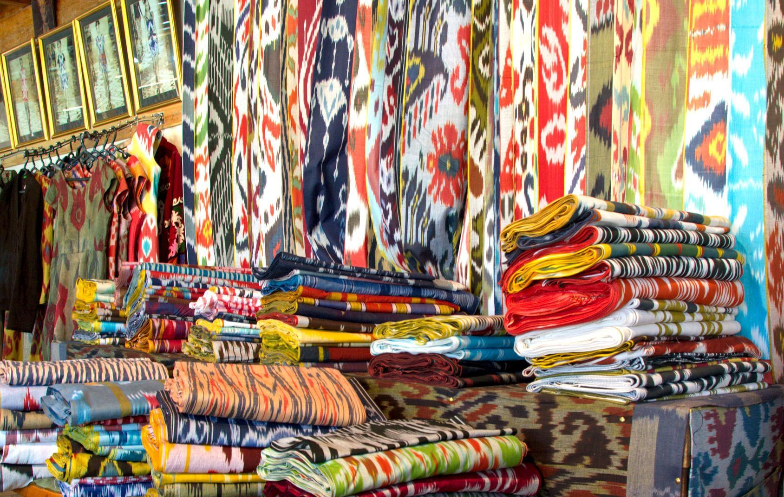
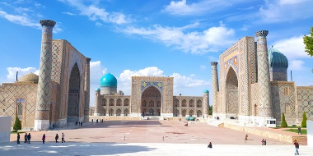
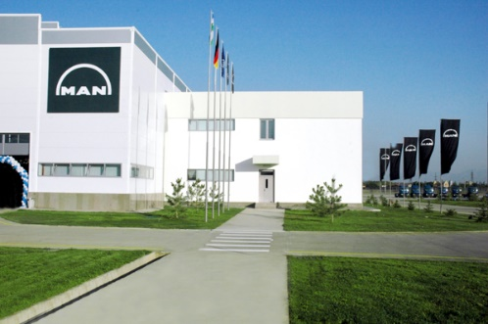
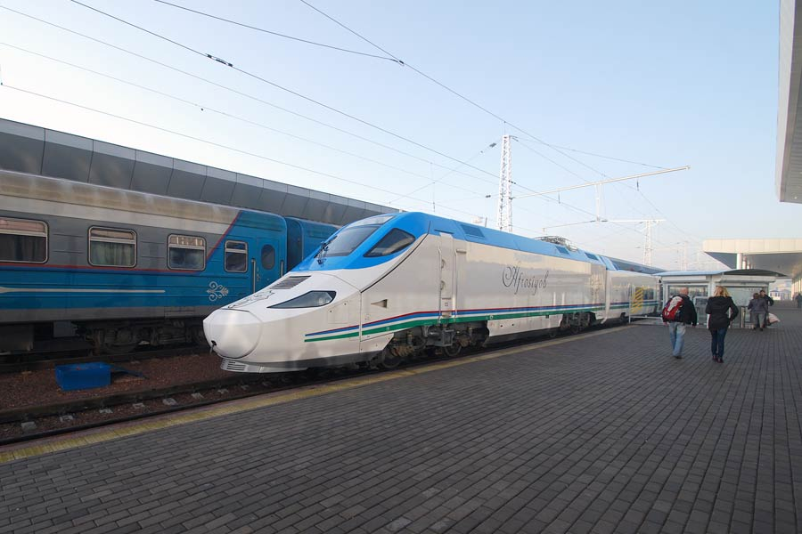
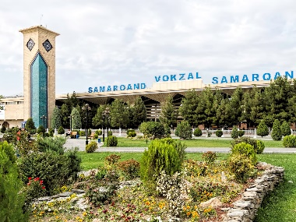
Notes:
© Copyright Showeet.com

Slide 10
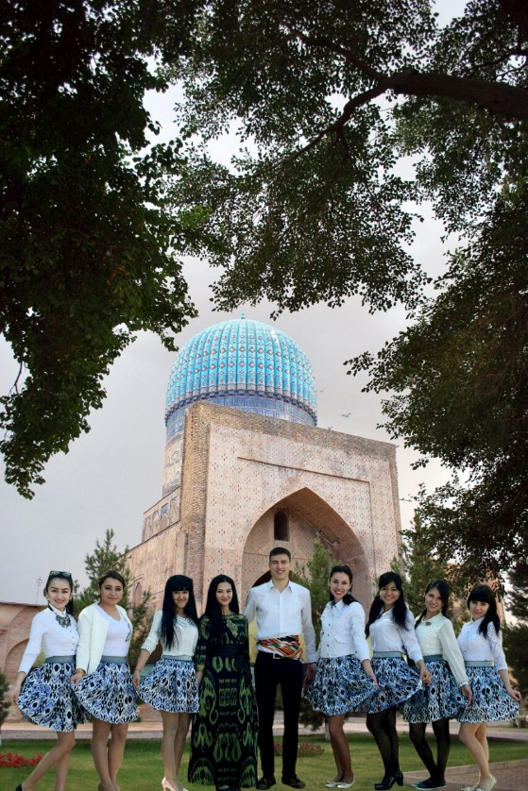
Department of International Relations
Phone: (+998 66) 239 10 79
Fax: (+998 66) 239 11 40
irossu@samdu.uz
Follow the news on our website:
www.samdu.uz

